Slide 1


MOVIE RECOMMENDATION
DATA SCIENCE
PROJECT
GROUP 6

Slide 2

wilkins Nzioka
Caroline Mbugua
Amad Growman
Our Team
Chair
Members
Priscilla Nzioka
Nicholas Njubi
Emmanuella Karisa
GROUP 6

Slide 3
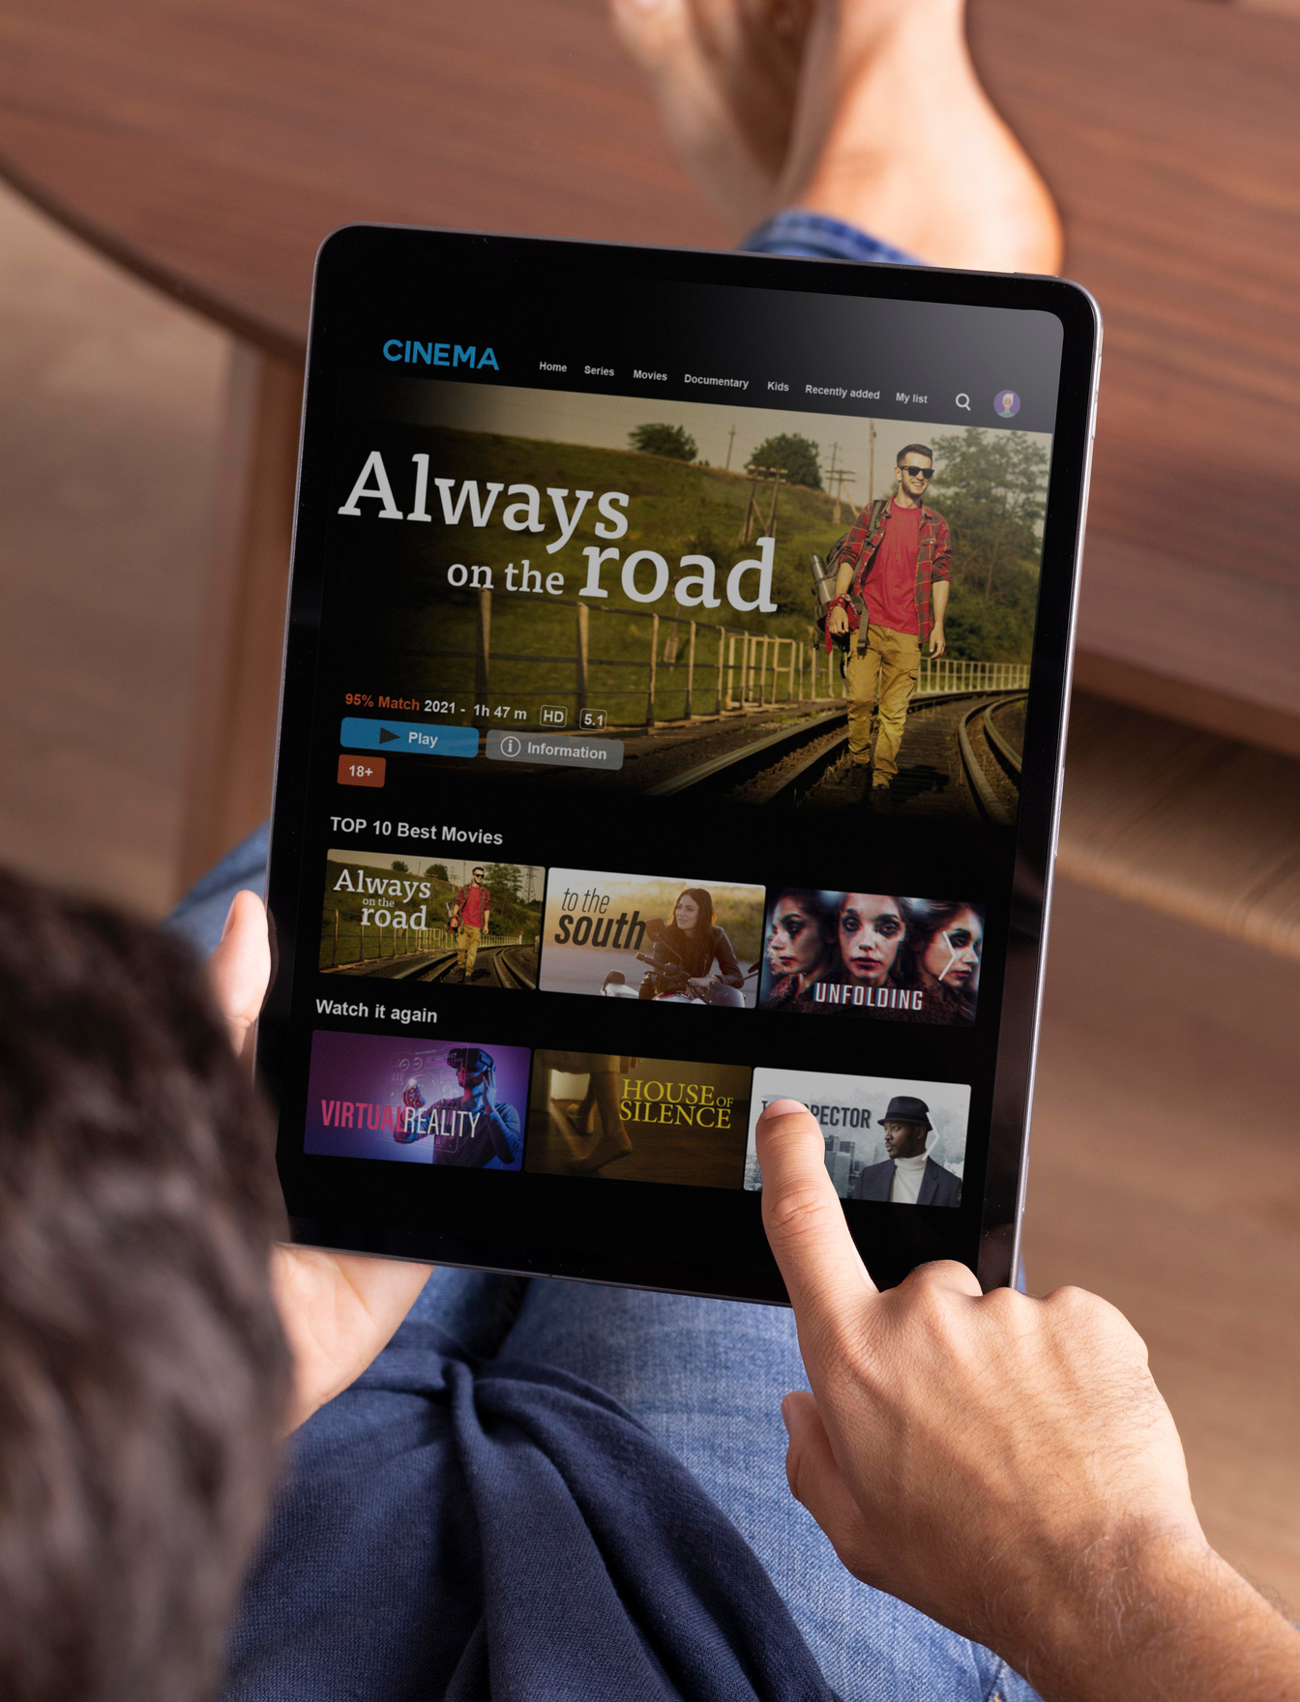
PROJECT SUMMARY
Jaba Movie Shop endeavors to optimize user engagement and satisfaction through the implementation of a sophisticated recommendation system. Leveraging the extensive movie database of MovieLens, the project aims to pair clients with films closely aligned with their preferences, prioritizing highly rated movies to ensure customer satisfaction. The primary objective is to develop a robust model that delivers top movie recommendations to users based on their ratings of other movies, employing machine learning algorithms like collaborative filtering and content-based filtering.
Through the implementation of advanced machine learning techniques and leveraging the rich dataset provided by MovieLens, Jaba Movie Shop seeks to enhance user engagement significantly. By providing tailored recommendations based on user reviews, tags, and ratings, the project aims to foster a positive user experience and ultimately improve customer satisfaction.

Slide 4

OUTLINE
1) Business Problem
2) Project Goal
3) Data
4) Methods
5) Results and Recommendations

Slide 5

BUSINESS PROBLEM
Jaba Movie Shop strives to enhance user engagement and satisfaction by implementing a recommendation system that utilizes the MovieLens dataset. Recognizing the significance of understanding consumer preferences and viewing behaviors in the competitive entertainment landscape, the Movie Shop analyzes user ratings and preferences to improve content recommendations. This initiative aims to cultivate stronger client loyalty and consolidate the shop's position as a premier entertainment provider.

Slide 6




PROJECT GOAL 1
Enhanced User Engagement:
By providing a platform where users receive tailored recommendations based on their reviews, tags, and ratings, the project seeks to enhance user engagement significantly.

Slide 7



PROJECT GOAL 2
Improved Customer Satisfaction:
Ultimately, the project aims to enhance overall customer satisfaction by delivering personalized recommendations that resonate with each individual user, thereby fostering a positive user experience.

Slide 8

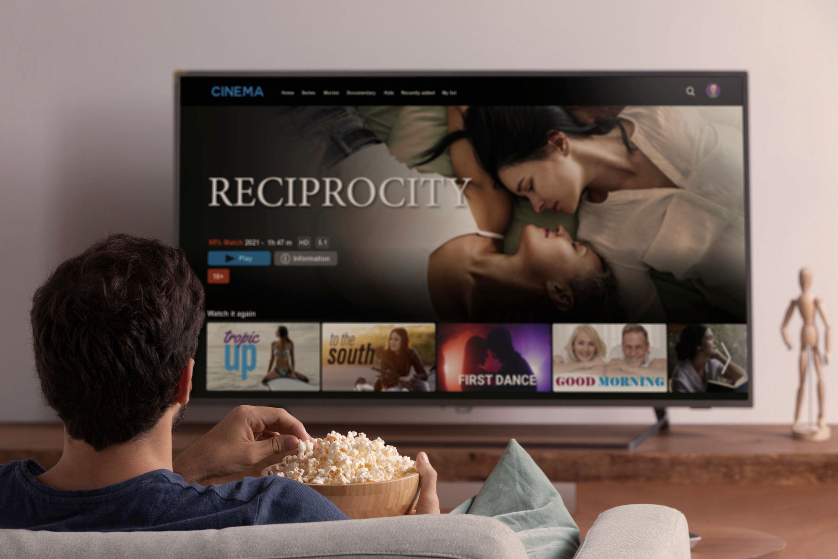
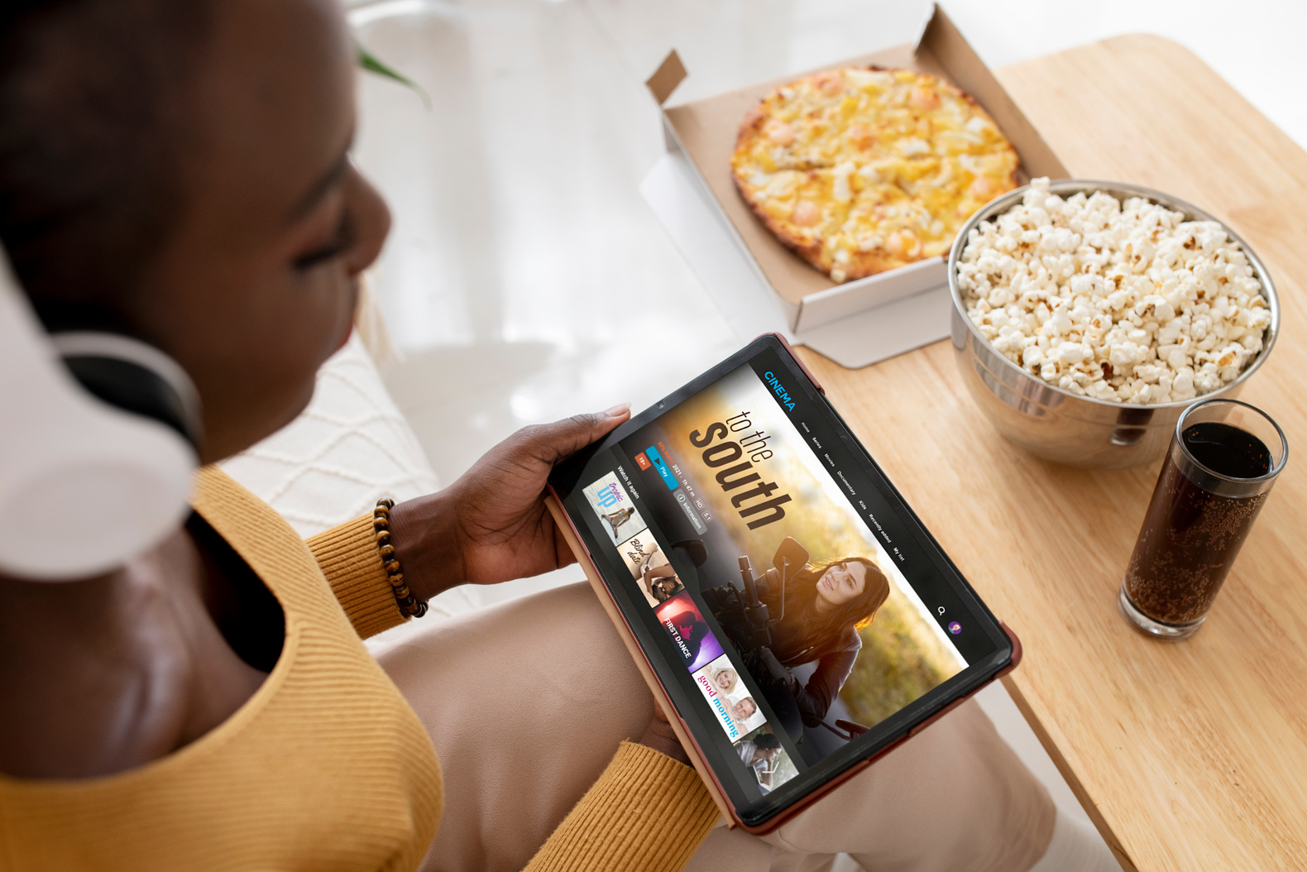
PROJECT GOAL 3
Top Movie Recommendations:
The core focus is on building a model capable of delivering top movie recommendations to users, ensuring they are exposed to content that aligns with their preferences and interests.

Slide 9

DATA
The dataset used in this project was obtained from rom the GroupLens research lab at the University of Minnesota, which contains 100,000 user ratings.

Slide 10

METHODOLOGY
1) Data Loading and understanding
2) Data Preparation
3) Distribution of data
4) Data Pre-processing
5) Model development and evaluaion
6) Model Optimization

Slide 11

RESULTS & RECOMMENDATIONS
The results are

Slide 12
THANK YOU

